Slide 1

Diagnosis of Conjunctivitis using Artificial Intelligence

Slide 2
Project Team
Bilal Faiz (BCSM-S21-025)
Muhammad Ans (BCSM-S21-045)
Muhammad Asim (BCSM-S21-004)
Supervisor: Neha Zulfiqar

Slide 3
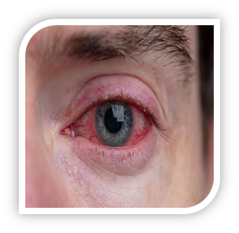
Introduction
Conjunctivitis involves inflammation of the eye's lining and sclera (Sindhuja et al., 2020).
Caused by allergies, bacterial, and viral infections (Sindhuja et al., 2020).
Highly infectious due to irritating fluids, requiring preventive measures (Pepose et al., 2020).
Common in the general population, with some more vulnerable to ocular problems (Khairallah & Kahloun, 2013).
Notes:
Sindhuja, K., Lomi, N., Asif, M. I., & Tandon, R. (2020). Clinical profile and prevalence of conjunctivitis in mild COVID-19 patients in a tertiary care COVID-19 hospital
Khairallah, M., & Kahloun, R. (2013). Ocular manifestations of emerging infectious diseases
Pepose JS, Sarda SP, Cheng WY, McCormick N, Cheung HC, Bobbili P, Joseph C, Duh MS. Direct and Indirect Costs of Infectious Conjunctivitis in a Commercially Insured Population in the United States

Slide 4
Symptoms of Conjunctivitis
Ocular redness (Sindhuja et al., 2020)
Itching (Azari & Barney, 2013)
Crusting on eyelashes at night (Azari & Barney, 2013)
Watery discharge (Sheikh et al., 2012)
Burning sensation (Sheikh et al., 2012)
Eyelid swelling (Bielory et al., 2021)
Conjunctival redness (Bielory et al., 2021)
Notes:
Sindhuja, K., Lomi, N., Asif, M. I., & Tandon, R. (2020). Clinical profile and prevalence of conjunctivitis in mild COVID-19 patients in a tertiary care COVID-19 hospital:
Azari, A. A., & Barney, N. P. (2013). Conjunctivitis: a systematic review of diagnosis and treatment.
Sheikh A, Hurwitz B, van Schayck CP, McLean S, Nurmatov U. Antibiotics versus placebo for acute bacterial conjunctivitis. Cochrane Database Syst Rev. 2012
Bielory BP, O'Brien TP, Bielory L. Management of allergic conjunctivitis: Clinical aspects, pharmacology, and emerging therapies. Expert Opin Pharmacother. 2021

Slide 5
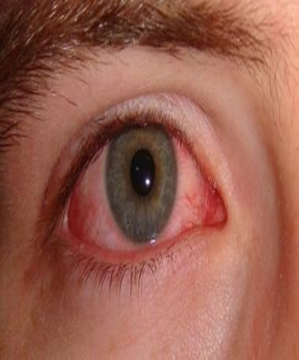
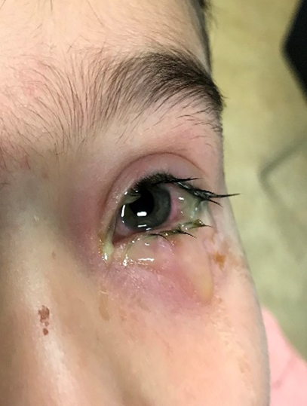
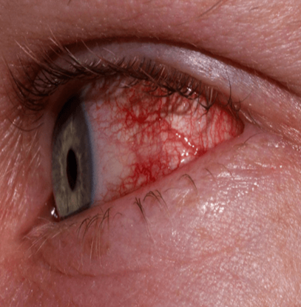
Types of pink eye
Viral conjunctivitis (Tabuchi et al. 2020)
Bacterial conjunctivitis (Bobade et al., 2023)
Allergic conjunctivitis (Akram et al., 2020)
Notes:
Tabuchi, H., & Masumoto, H. (2020). Objective evaluation of allergic conjunctival disease (with a focus on the application of artificial intelligence technology). Allergology International, 69(4), 505-509
Bobade, L., Thote, M., Tabhane, R., Madke, P., Shrawankar, M., & Sambhare, P. EYE DISEASE IDENTIFICATION.
3. AKRAM, ASHRAFI and DEBNATH, RAMESWAR (2020) "An automated eye disease recognition system from visual content of facial images using machine learning techniques," Turkish Journal of Electrical Engineering and Computer Sciences: Vol. 28: No. 2, Article 23

Slide 6
Affected Population
Adenoviruses are extremely infectious, with an estimated 20 million Americans infected each year.
Significant data from Pakistan (75%), Turkey (44%), and China (39.8%) further support these high infection rates.
On September 28, 2023, an epidemic of adenovirus ophthalmopathy occurred in Pakistan, affecting 86,133 people, mostly in Punjab province.
The average number of cases during the epidemic was 13,000 per day (Idrees et al., 2024).
Notes:
Idrees, Muhammad MBBSa; Tariq, Waleed MBBSb; Jamil, Hashaam MBBSc; Yaqub, Aliza MBBSe; Tahir, Muhammad Junaid MBBSd; Mahmmoud Fadelallah Eljack, Mohammed MBBSg; Ahmed, Ali PhDf. Pakistan’s battle against adenoviral conjunctivitis and its economic implications. International Journal of Surgery:

Slide 7
Literature Review
Used deep learning and machine learning algorithms e.g. CNN, ANN, Resnet50, VGG16 and VGG19 , Yolo v5
Used Different Classifiers including SVM, Random Forest etc.
Achieved accuracies between 83.33% to 98.79%
Dataset included different images related to eye diseases
The issue of class imbalance in datasets is particularly noted in the work by İbrahim et al. (2024) , which provides a robust framework for the automated detection of pink eye.
Notes:
Soysa, A., & De Silva, D. (2020). A mobile base application for cataract and conjunctivitis detection. In Proceedings of ICACT (pp. 76-78)
Mondal, S., Banerjee, S., Mukherjee, S., Ganguly, A., & Sengupta, D. (2022). Deep Classifier for Conjunctivitis–A Three-Fold Binary Approach
M. Rivero-Palacio, W. Alfonso-Morales and E. Caicedo-Bravo, "Mobile Application for Anemia Detection through Ocular Conjunctiva Images," 2021 IEEE Colombian Research Conference on Applications of Computational Intelligence
Rashid, F., Abate, J., & Abdi, A. (2024). Multiclass Classification and Identification of the External Eye Diseases using Deep CNN. Indian Journal of Science and Technology, 17(12), 1107-1116
Mekonnen, S., & Abebe, M. (2023). Cattle Pinkeye Disease Classification using Machine Learning. Ethiopian International Journal of Engineering and Technology, 1(2), 28-38.
Prajna, N. V., Lalitha, P., Teja, G. V., Gunasekaran, R., Sharma, S. S., Hinterwirth, A., ... & Doan, T. (2022).
Gunay, M., Goceri, E., & Danisman, T. (2015, December). Automated detection of adenoviral conjunctivitis disease from facial images using machine learning. In 2015 IEEE 14th International Conference on Machine Learning and Applications (ICMLA) (pp. 1204-1209). IEEE.
İbrahim, K. A. Y. A., & ÇINAR, İ. (2024). Evaluation of Machine Learning and Deep Learning Approaches for Automatic Detection of Eye Diseases. Intelligent Methods In Engineering Sciences, 3(1), 37-45.
Mukherjee, P., Bhattacharyya, I., Mullick, M., Kumar, R., Roy, N. D., & Mahmud, M. (2021, July). icondet: An intelligent portable healthcare app for the detection of conjunctivitis.

Slide 8
Problem Statement
The diagnosis of ophthalmic disorders often relies on elusive examinations, especially in genetic conditions. Our review identified class imbalance and model complexity as major issues, leading to overfitting and misleadingly high accuracy. We propose customized methods to manage these imbalances and improve pattern recognition, aiming to enhance algorithm robustness and reliability across diverse datasets for better real-world applicability.
Notes:
Gunay, M., Goceri, E., & Danisman, T. (2015, December). Automated detection of adenoviral conjunctivitis disease from facial images using machine learning. In 2015 IEEE 14th International Conference on Machine Learning and Applications (ICMLA) (pp. 1204-1209). IEEE.
Mukherjee, P., Bhattacharyya, I., Mullick, M., Kumar, R., Roy, N. D., & Mahmud, M. (2021, July). icondet: An intelligent portable healthcare app for the detection of conjunctivitis.
İbrahim, K. A. Y. A., & ÇINAR, İ. (2024). Evaluation of Machine Learning and Deep Learning Approaches for Automatic Detection of Eye Diseases. Intelligent Methods In Engineering Sciences, 3(1), 37-45.

Slide 9
Objective
Develop comprehensive literature on conjunctivitis diagnosis.
Accurately predict difference between conjunctivitis-affected and healthy eyes.
Address class imbalances and identify complex patterns in datasets.
Use a dataset of conjunctivitis types and Deep Learning algorithm for training.
Train the model to recognize viral, bacterial, and allergic conjunctivitis.

Slide 10
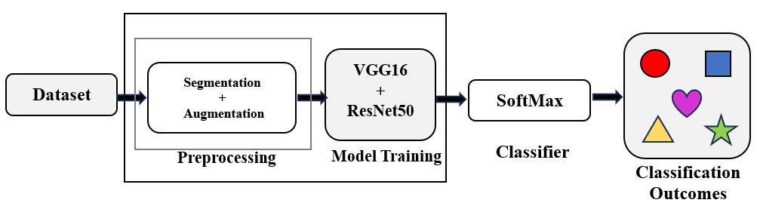
Methodology

Slide 11
Implementation
Data Collection
Preprocessing
Segmentation + Augmentation
Model Training
Classifiers
Output

Slide 12
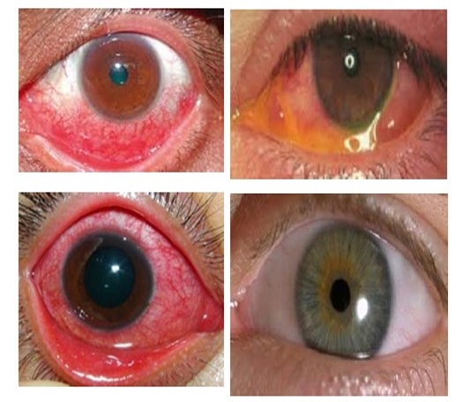
Dataset
Dataset consist 1600 images comprising of four different classes
Collected from different online sources e.g (roboflow.com)
Our dataset include labeled classes of viral, bacterial, allergic conjunctivitis and also contain healthy eye
Notes:
1. human_pink_eyes_virus Object Detection Dataset and Pre-Trained Model by namnhat (roboflow.com)
2. eye conjunctiva detector Dataset > Overview (roboflow.com)
3. Zhang, R., Walshe, C., Liu, Z., Guan, L., Muller, K., Whritner, J., ... & Ballard, D. (2020, April). Atari-head: Atari human eye-tracking and demonstration dataset. In Proceedings of the AAAI conference on artificial intelligence (Vol. 34, No. 04, pp. 6811-6820)
4. Guo, Y., Zhang, L., & Liu, J. (2021). Conjunctivitis detection using convolutional neural networks. International Journal of Medical Informatics, 150, 104471.
5. Li, J., Zhang, Y., Wu, Q., Wang, D., & Zhang, Q. (2021). A deep learning model for conjunctivitis recognition in clinical images. Journal of Medical Systems, 45(12), 1-9.

Slide 13
Segmentation and Augmentation
Platform: Roboflow tools for precise segmentation
Purpose: Highlight critical regions, like redness and vessel structure, for accurate diagnosis
Outcome: High-quality, pre-processed images that improve model learning
Data augmentation helps to increase the size of dataset for training a model without collecting new data.
We used zooming, rotation, and horizontal shift. By applying the augmentation more image dataset were generated.
Notes:
Mukherjee, P., Bhattacharyya, I., Mullick, M., Kumar, R., Roy, N. D., & Mahmud, M. (2021, July). i condet: An intelligent portable healthcare app for the detection of conjunctivitis. In International Conference on Applied Intelligence and Informatics (pp. 29-42). Cham: Springer International Publishing.

Slide 14
Proposed Hybrid Model Architecture
Models Used: VGG16 and ResNet50 Hybrid Model
Process: Dual feature extraction for detailed and high-level insights
Unified Feature Vector: Combines fine features with structural details for enhanced classification accuracy
Mechanism: Combines VGG16 and ResNet50 outputs into a single feature vector
Benefit: Minimizes weaknesses of individual models, optimizing accuracy by retaining both intricate and abstract patterns
Notes:
He, K., Zhang, X., Ren, S., & Sun, J. (2016). Deep Residual Learning for Image Recognition. In Proceedings of the IEEE conference on computer vision and pattern recognition.
Simonyan, K., & Zisserman, A. (2014). Very Deep Convolutional Networks for Large-Scale Image Recognition.
Bishop, C. M. (2006). Pattern Recognition and Machine Learning. Springer.

Slide 15
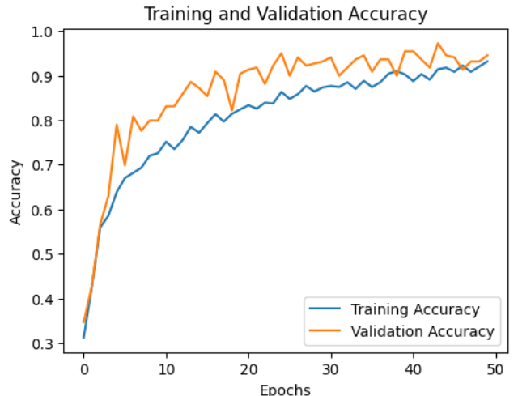
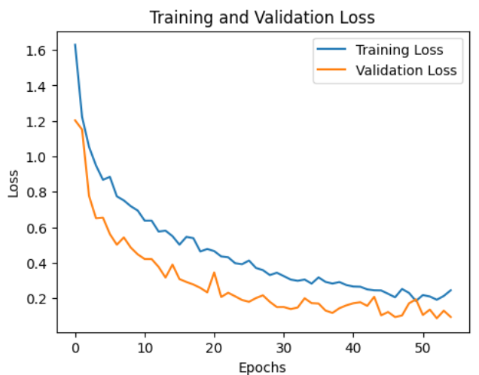
Experimental Results
The experimental result shows training accuracy, 93.84%, and validation accuracy as 94%.

Slide 16
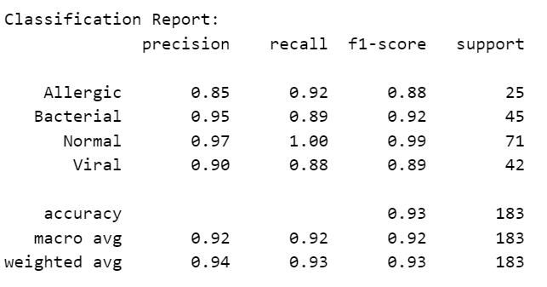
Experimental Results

Slide 17
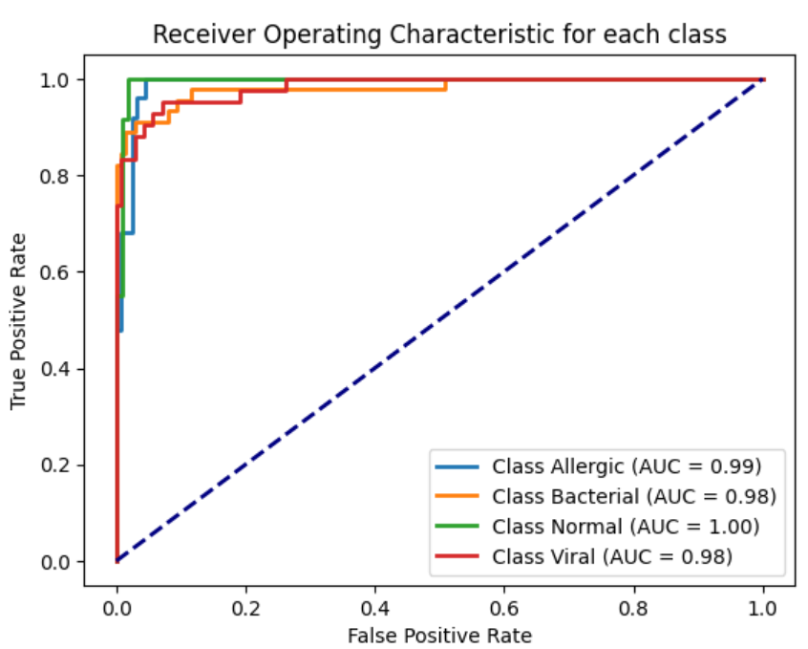
Experimental Results
A clear graphical depiction of the trade-off between true positive rate and false positive rate for multiclass classification tasks is receiver operating characteristics (RoC) analysis.

Slide 18
Comparison
Article Reference | Algorithm | Dataset | Outcome
Ghani et al (2021) | Inception-V3 and VGG-16 architectures | Dataset with 1563 pictures of different eye diseases divided into 25 groups | 90.01%
Nigudgi et al. (2023) | CNN model | Labeled conjunctivitis effected eye photos | 87%
Soysa et al. (2020) | Convolutional (CNN) and deep neural networks (DNN) | Images including conjunctivitis, cataracts, and normal eye photos | 83.33%
Mukherjee et al. (2021) | Convolutional neural networks (CNNs), EfficientNet | Annotated photos of healthy and diseased eyes | 84%
Purposed Model | VGG-16 and ResNet-50 hybrid model | Dataset contain viral, bacterial, allergic and healthy eyes label image. | 93.44%
Notes:
Ghani, F., Sattar, U., Narmeen, M., Wazir Khan, H., & Mehmood, A. (2021). A methodology for glaucoma disease detection using deep learning techniques. International Journal of Computing and Digital System.
Nagalaxmi Nigudgi and Dr. Sridevi Hosmani. " CONJUNCTIVITIS EYE DETECTION AND PERSONALIZED DRUG RECOMMENDATION SYSTEM USING CNN ", International Journal of Creative Research Thoughts (IJCRT), ISSN:2320-2882, Vol.11, Issue 8, pp.h92-h96, August 2023,
Soysa, A., & De Silva, D. (2020). A mobile base application for cataract and conjunctivitis detection. In Proceedings of ICACT (pp. 76-78).
Mukherjee, P., Bhattacharyya, I., Mullick, M., Kumar, R., Roy, N. D., & Mahmud, M. (2021, July). i condet: An intelligent portable healthcare app for the detection of conjunctivitis

Slide 19
Conclusion
Summary: AI-based detection models offer accessible, rapid diagnostics
Impact: Potential to bring quality eye care to rural areas
Future: Develop more hybrid models to improve accuracy and integrate into mobile apps for wider accessibility

Slide 20
Report
..\Research_Report_final[1] fyp2.docx

Slide 21
THANKS

